Slide 1
A8: Interactive High-Fi Prototype
memreprise
Casey Nguyen, Sophie Wu, Kayla Patterson, Caroline Tran

Slide 2

memreprise
where music and memories meet
Notes:
Project name and value proposition

Slide 3
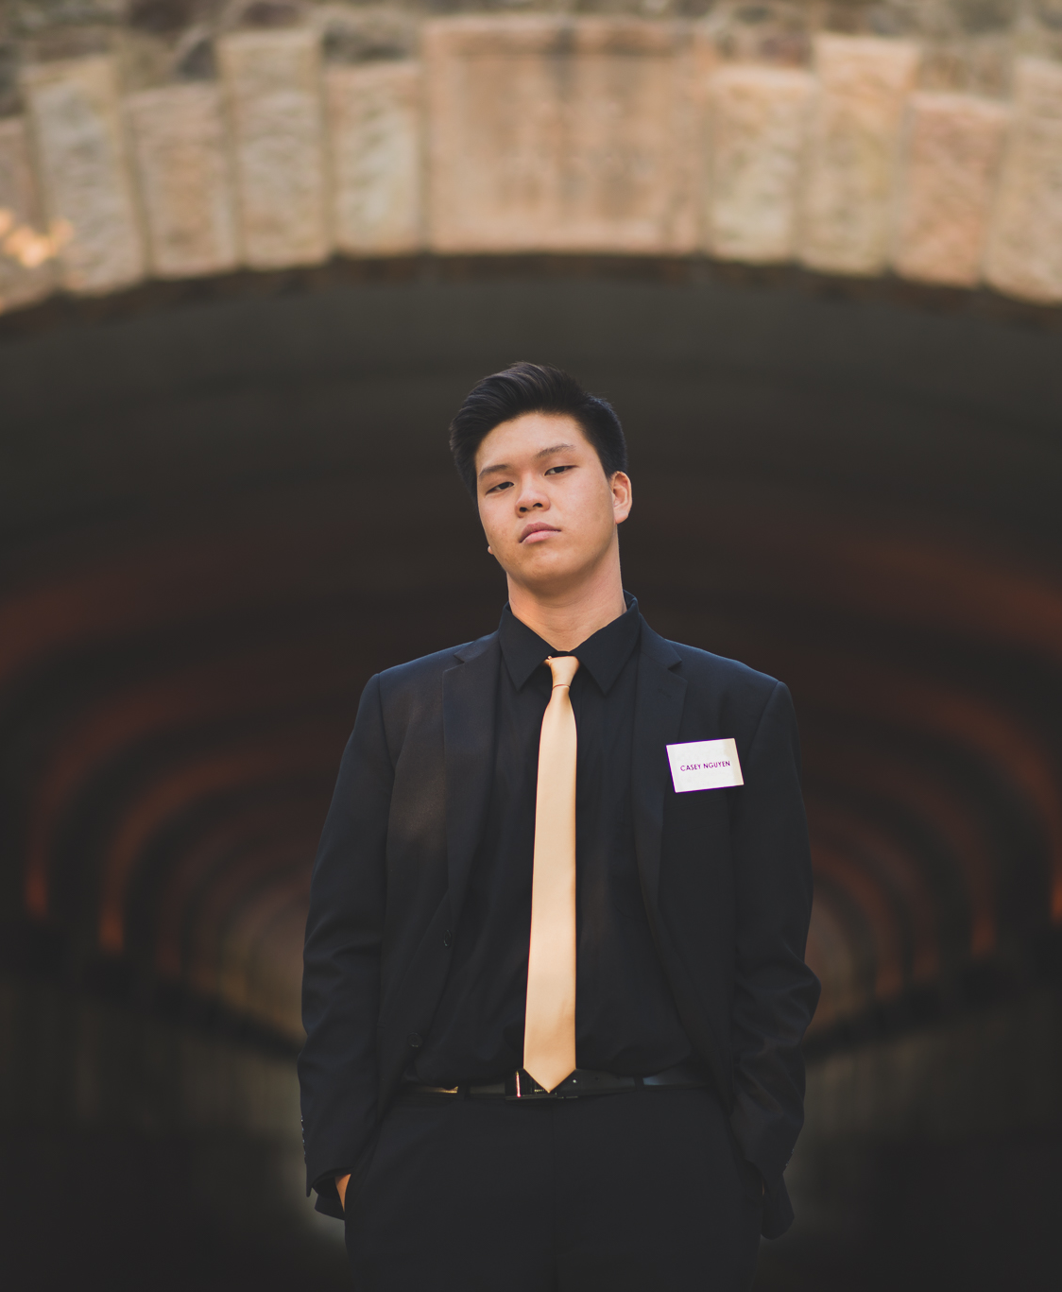
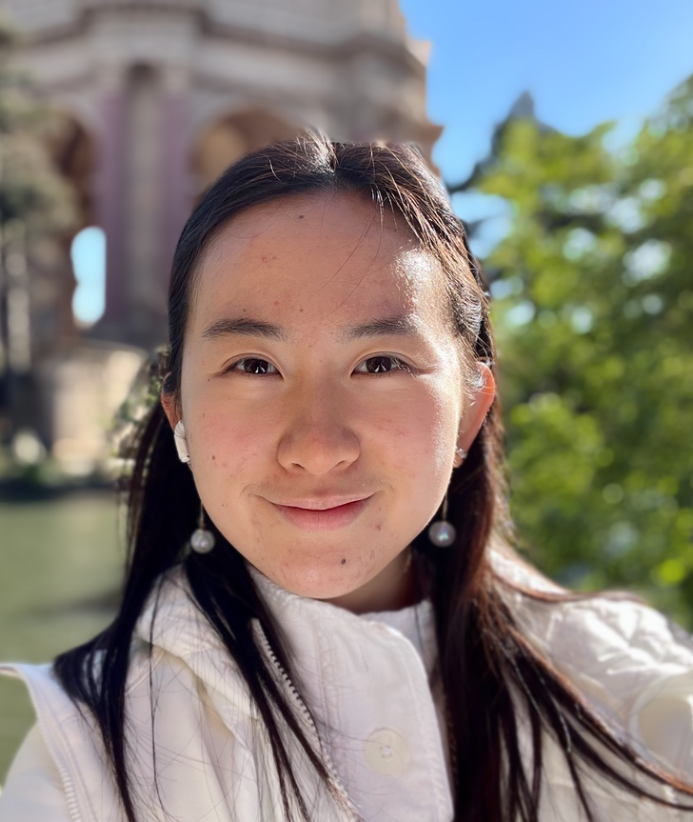


Team Members
Casey Nguyen
BSCS ‘24, MSCS ‘24
Full Stack Developer
Sophie Wu
BSCS ‘24, MSCS ‘25
Full Stack Developer
Kayla Patterson
MSCS ‘24
Website, Frontend Developer
Caroline Tran
BSCS ‘23, MSCS ‘25
Full Stack Developer
Notes:
Team member names & roles

Slide 4
Problem & Solution Overview
Problem
Solution
People often have deep, yet hard-to-quantify associations with their favorite music.
These associations go undocumented and unshared
An app that prompts you daily to:
Log the song you’re currently listening to
Associate it with a
themed question
Notes:
Problem/solution overview

Slide 5
Presentation Outline
01
02
03
04
Heuristics Evaluation Results
(slides 6 - 11)
UI & Product Revisions
(slides 12 - 18)
Prototype Implementation Status
(slides 19 - 24)
Demo of Prototype
(slides 25 - 26)
Notes:
Talk Outline

Slide 6
01
Heuristics Evaluation Results

Slide 7


High-Level Summary of Results
Top Offenders
37 Total Violations
(8 Severity 3 Violations, 0 Severity 4 Violations)
Most Common
Most Severe
(1+ Severity 3 Violation)
2 Severity 3 Violations:
H2: Match System and Real World
H3: User Control
1 Severity 3 Violations:
H1: Visibility of System Status
H6: Recognition Not Recall
H8: Minimalist Design
H11: Accessibility
H4: Consistency and Standards
H8: Minimalist Design
H7: Efficiency of User
Notes:
Summary of the results

Slide 8
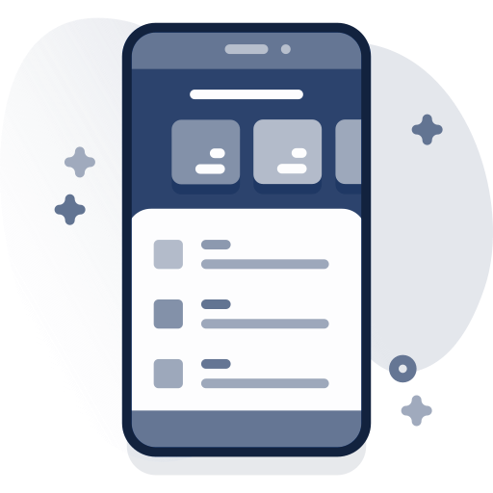


High-Level Summary of Results
Visual Design (Aesthetics, Accessibility, and Consistency)
  Usable and legible, interactive elements and text
  Standardize size, labeling, and layout – information hierarchy
More Power to the User (Control, Flexibility, and Visibility)
  Add features for greater user control over posting (privacy, deletion, incorporating play history)
  Highlight existing areas of user control
Terminology
  Rename and re-label features to reduce confusion
  Create documentation for MemReprise specific terms and features
Notes:
Summary of the results

Slide 9
Simple Task
Share a song on memreprise
Severity
Description
Fix
3
Users can’t view any content without posting
Allow users to view old posts without posting
3
There’s no indication of privacy level and audience when posting
Add privacy setting menu in the post preview
3
No explanation for making post
Create onboarding screens
Notes:
Additional details on severity 3-4 violations

Slide 10
Moderate Task
Discover music from other users with similar associations
Severity
Description
Fix
3
Unclear that “Charts” tab was where to go to discover music
Rename tab to “Discover”, and add labels to clarify
3
Text sizes across this task flow are very small
Increase and standardize text, sizes, & post layout
3
Controls and interactive elements are very small
Increase & standardize size of interactive elements
Notes:
Additional details on severity 3-4 violations

Slide 11
Complex Task
Create personalized playlist from songs you posted shared
Severity
Description
Fix
3
The term “Reprise” is unfamiliar to users
Explain term, functionality in onboarding screens
3
Calendar view of a user’s activity is organized in an confusing way
Add date labels & white space separation to better reflect chronological layout
3
Users cannot delete posts
Create onboarding screens
Notes:
Additional details on severity 3-4 violations

Slide 12
02
UI & Product Revisions

Slide 13
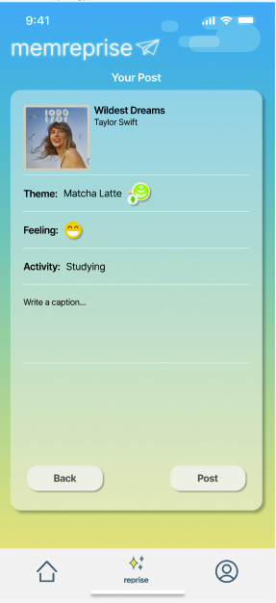
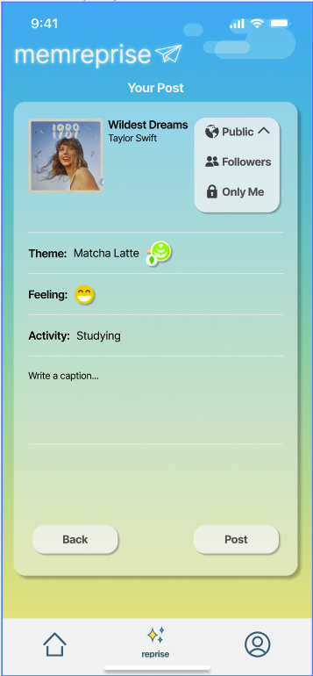
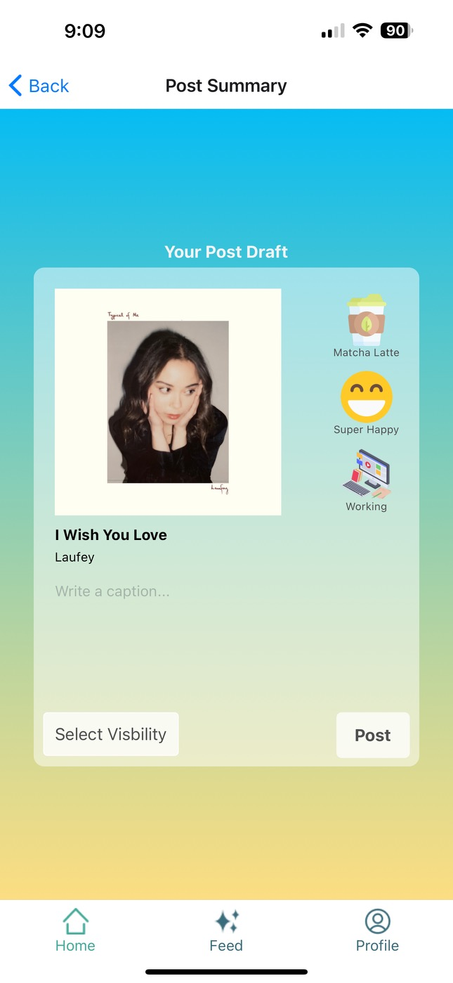
Post Overview
Before
After
Rationale:
User may not want to share post to everyone
Provides a memory archive for each user
Design is more legible
Progress towards usability goals:
Power to the user
Authentic posts
Personalized community
Notes:
Before and after shots + rationale

Slide 14
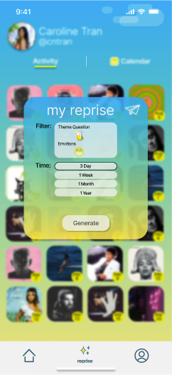

My Reprise Pop-Up
Before
After
Rationale:
Theme didn’t have a clear meaning
Filtering didn’t contain all options seen previously
Progress towards usability goals:
Gives user more autonomy on what to select
Specific between activity or emotions
Notes:
Before and after shots + rationale

Slide 15
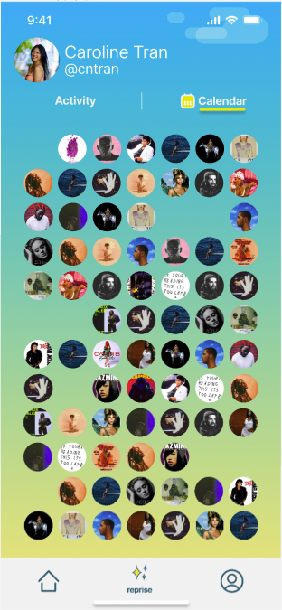
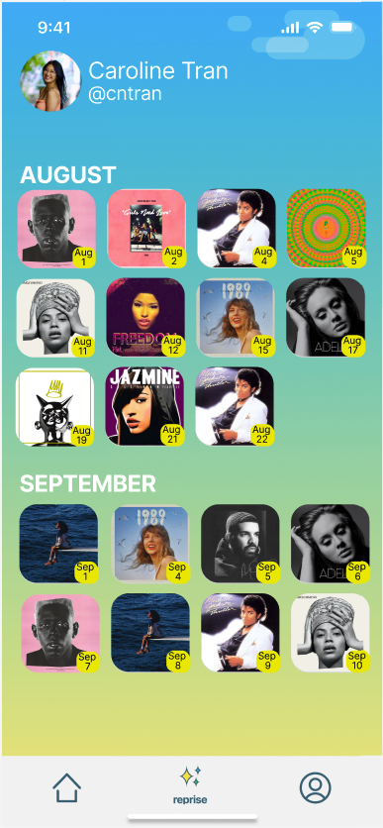
Calendar Activity
Before
After
Rationale:
Circles under calendar were too small and difficult to see
Circle icons not having dates were confusing
Progress towards usability goals:
Easier to see and click on
Clear what month these posts occurred on
Notes:
Before and after shots + rationale

Slide 16
New Screens Implemented
Notes:
Before and after shots + rationale

Slide 17
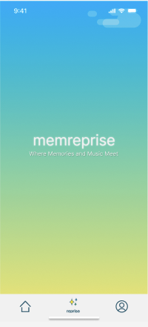
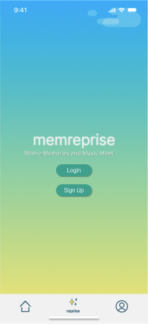
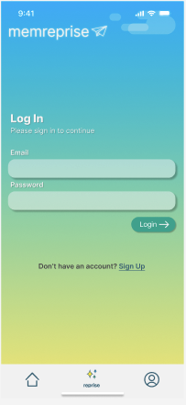
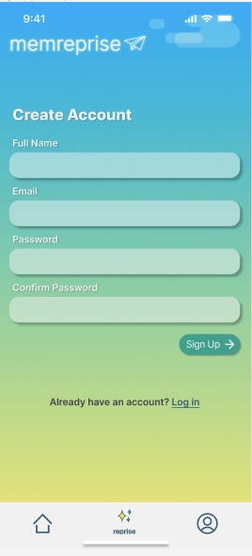
Login and SignUp
Rationale:
New users can be identified and led through tutorial
Progress towards usability goals:
Once a user signs in, their information will be saved
Allows for user Spotify music to easily be accessessible
Smaller learning curve
Notes:
Before and after shots + rationale

Slide 18
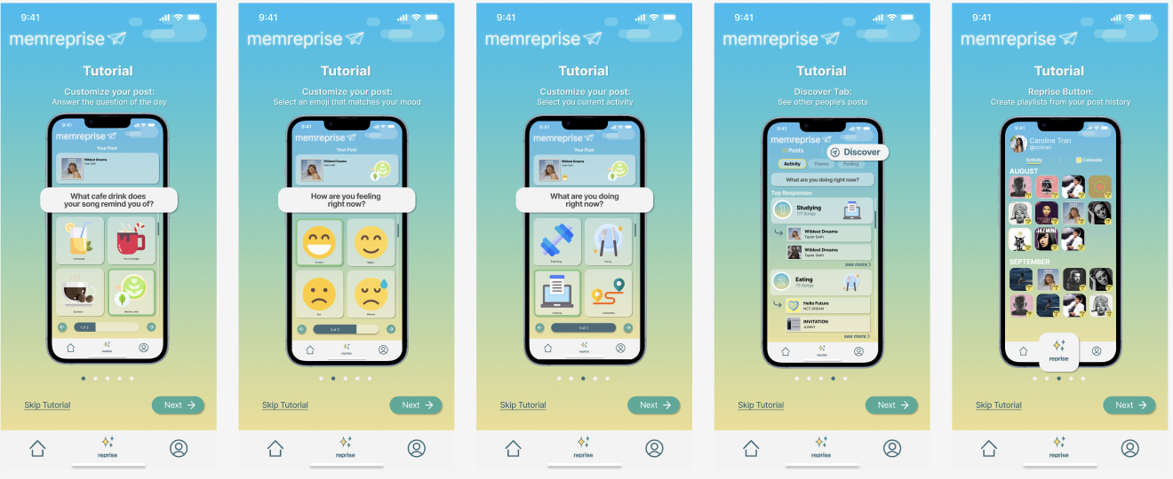
Tutorial
Rationale:
Users can could be potentially confused on how to work the app
Step-to-step guide to help with this
Progress towards usability goals:
Helps users understand the app before jumping straight in
Notes:
Before and after shots + rationale

Slide 19
03
Prototype Implementation Status

Slide 20
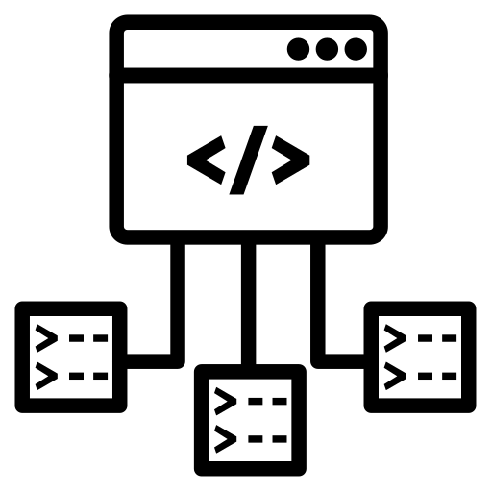



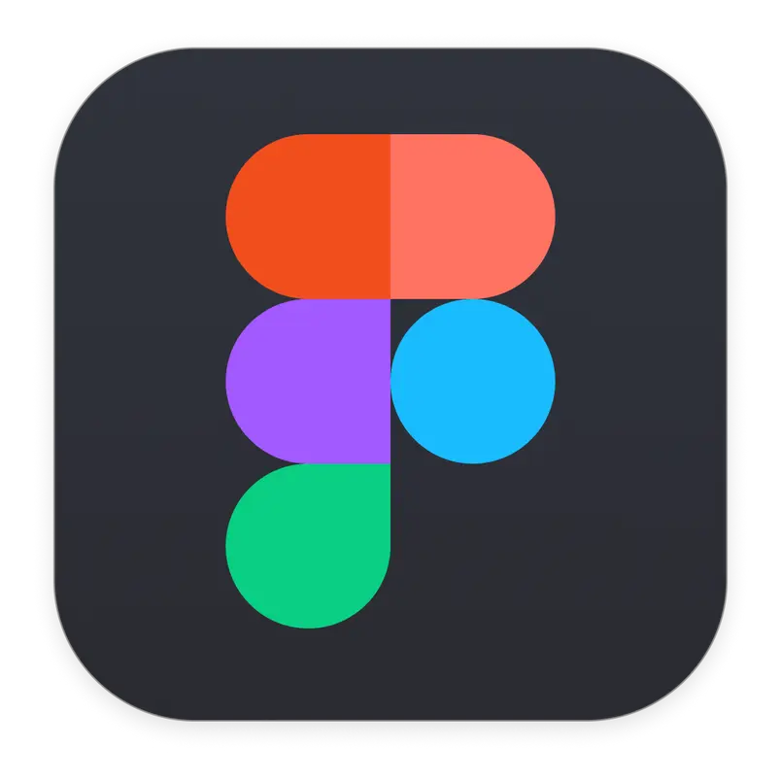
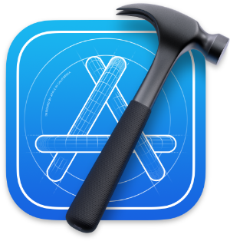



Framework & Tools Used
Framework
Tools Used
React Native
Expo Go
Figma
XCode
GitHub
VSCode: Prettier Extension
Spotify Developer API
Notes:
Framework: React Native and Expo
Tools Used:
Figma
VSCode
Prettier extension
Xcode for the simulator
Spotify Developer API
github

Slide 21
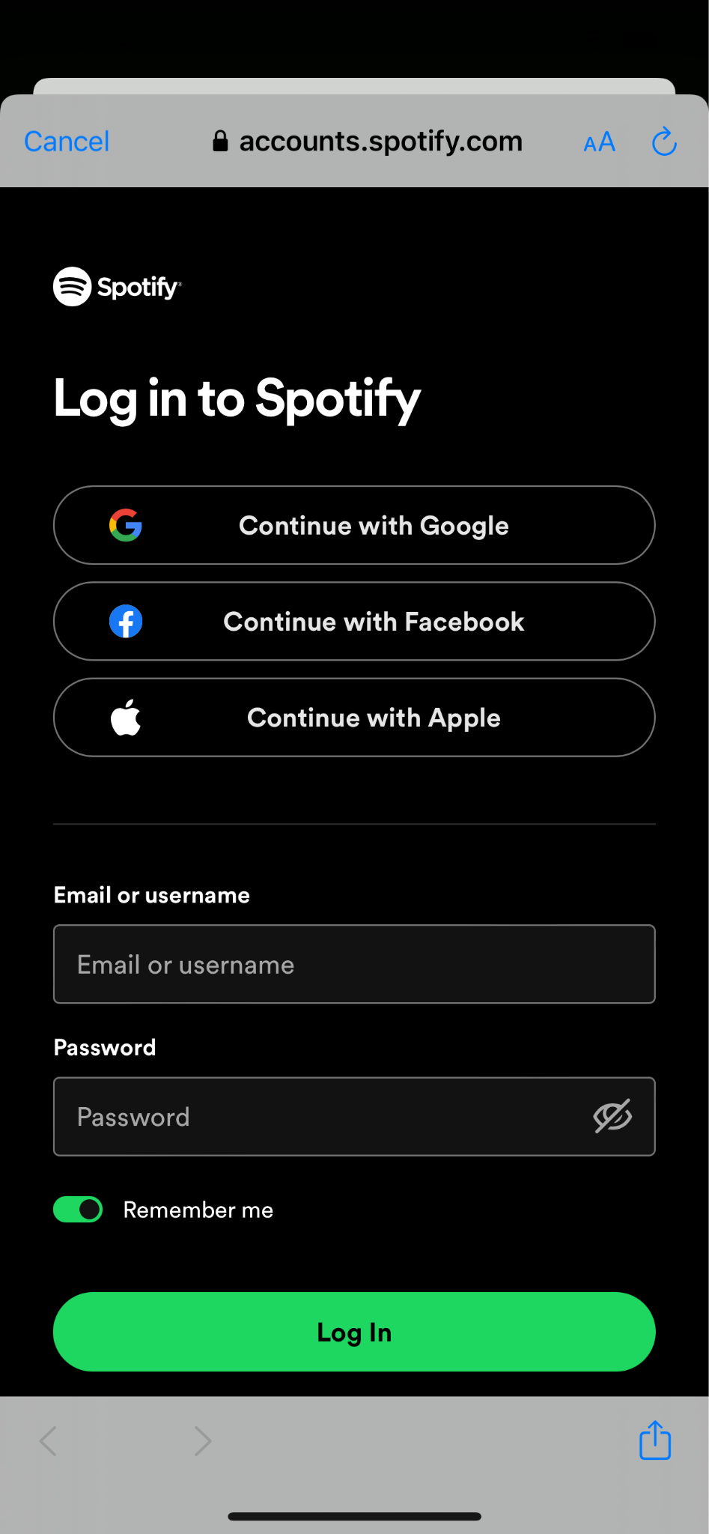
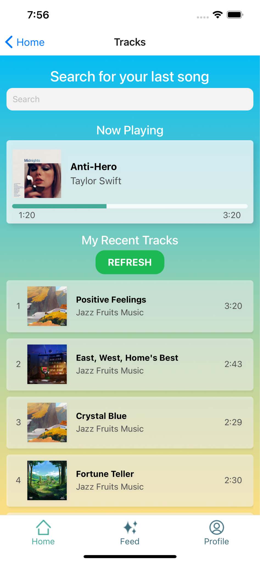
Implemented Features
Spotify API
Live Song Retrieval
Current Song Progress
All songs from Spotify Library can be searched for in the app
Pulls user’s now playing song so user does not have to search
Communicates status of system and shows current song playing
Notes:
Connect to spotify + song look up from spotify api
Retrieve recent songs and refresh recent songs
If user is currently listening to music, will display and have song progress goin

Slide 22
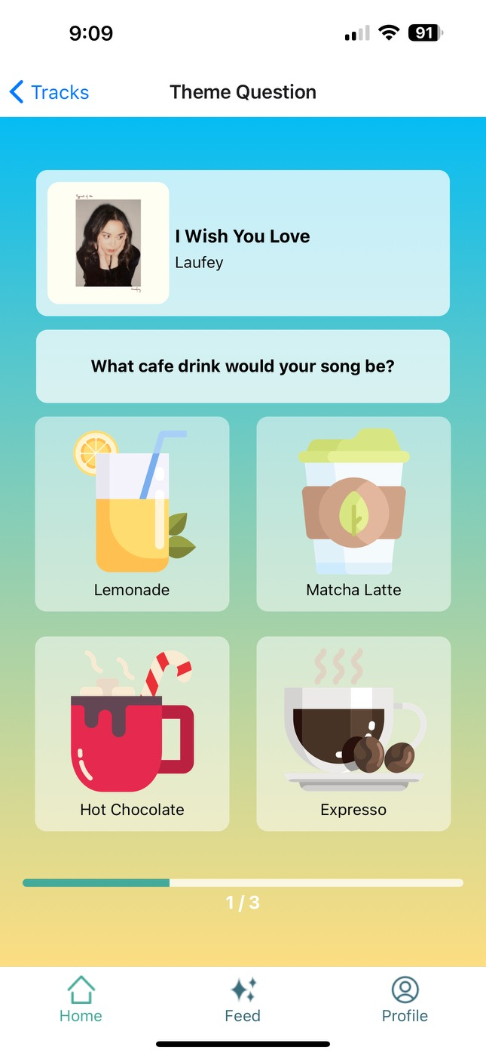
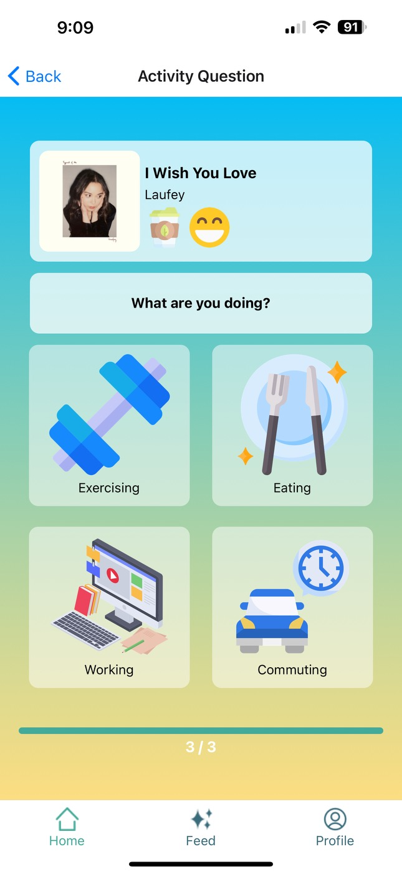

Implemented Features
Questionnaire
Progress Bar
Posts + Visibility
Users can select different options related to their song
Indicates how many more questions the user has to answer
Users can now write a caption with their post and select visibility
Notes:
Connect to spotify + song look up from spotify api
Retrieve recent songs and refresh recent songs
If user is currently listening to music, will display and have song progress goin

Slide 23
Unimplemented Features & Next Steps
Log In
12/1 - 12 / 2
Work on LogIn page containing email and password field
User database
12/2 - 12/4
Work on saving user info to database and access it on our app
Export Playlist
12/3 - 12/5
Create button to export one’s reprise playlist to 3rd party apps
Reprise Button
12/2 - 12/4
Create pop up where user can filter through their memories
Sign Up + Tutorial
12/1 - 12/3
Create signup page that contains necessary credentials. Tutorial will have a a step-by-step
Discover Playlists
12/1 - 12/3
Create page for users to see other songs based on emotions, activity, etc.
Calendar
12/1 - 12/5
Created calendar page showing songs posted in different months
Profile Exploration
12/3-12/6
Create profile page and allow users to be able to click anyone’s profile on any page
Notes:
Unimplemented features and plans to finish
Log in
Sign up + tutorial
User database → Supabase
Discover playlists → filtering on static user database
Reprise button → filtering from past posts of user
Calendar → visual of post history
Export playlist → wiring + the filtering
Profile exploration

Slide 24
Wizard of Oz Techniques + Hard Coded Aspects
Feed: User posts are static
User Data: profile & post history
Top 3 playlists and results for each category generated from static data
Notes:
Feed: User posts
Other user data → supabase
Top 3 playlists and results for each category
User calendar with past posts collage

Slide 25
Issues or Questions
Q1
Q2
Q3
How to address non-spotify users?
Is it possible to have multiple/randomized theme questions of the day?
Should we prioritize popularity or how recent a post is?
Notes:
Anything we are still unsure about and would like feedback on
How to address non-spotify users?
Getting around Spotify authentication
Is it feasible to have multiple/randomized theme questions of the day
How to show information people want to see → tags
Feed: should we prioritize popularity or how recent a post is? → this is static

Slide 26
04
Demo of Prototype

Slide 27
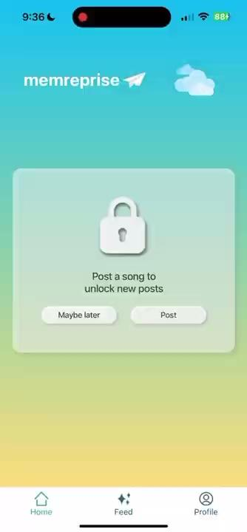
Notes:
Screen recording of the demo → talk over the recording live or have audio in the recording as well

Slide 28
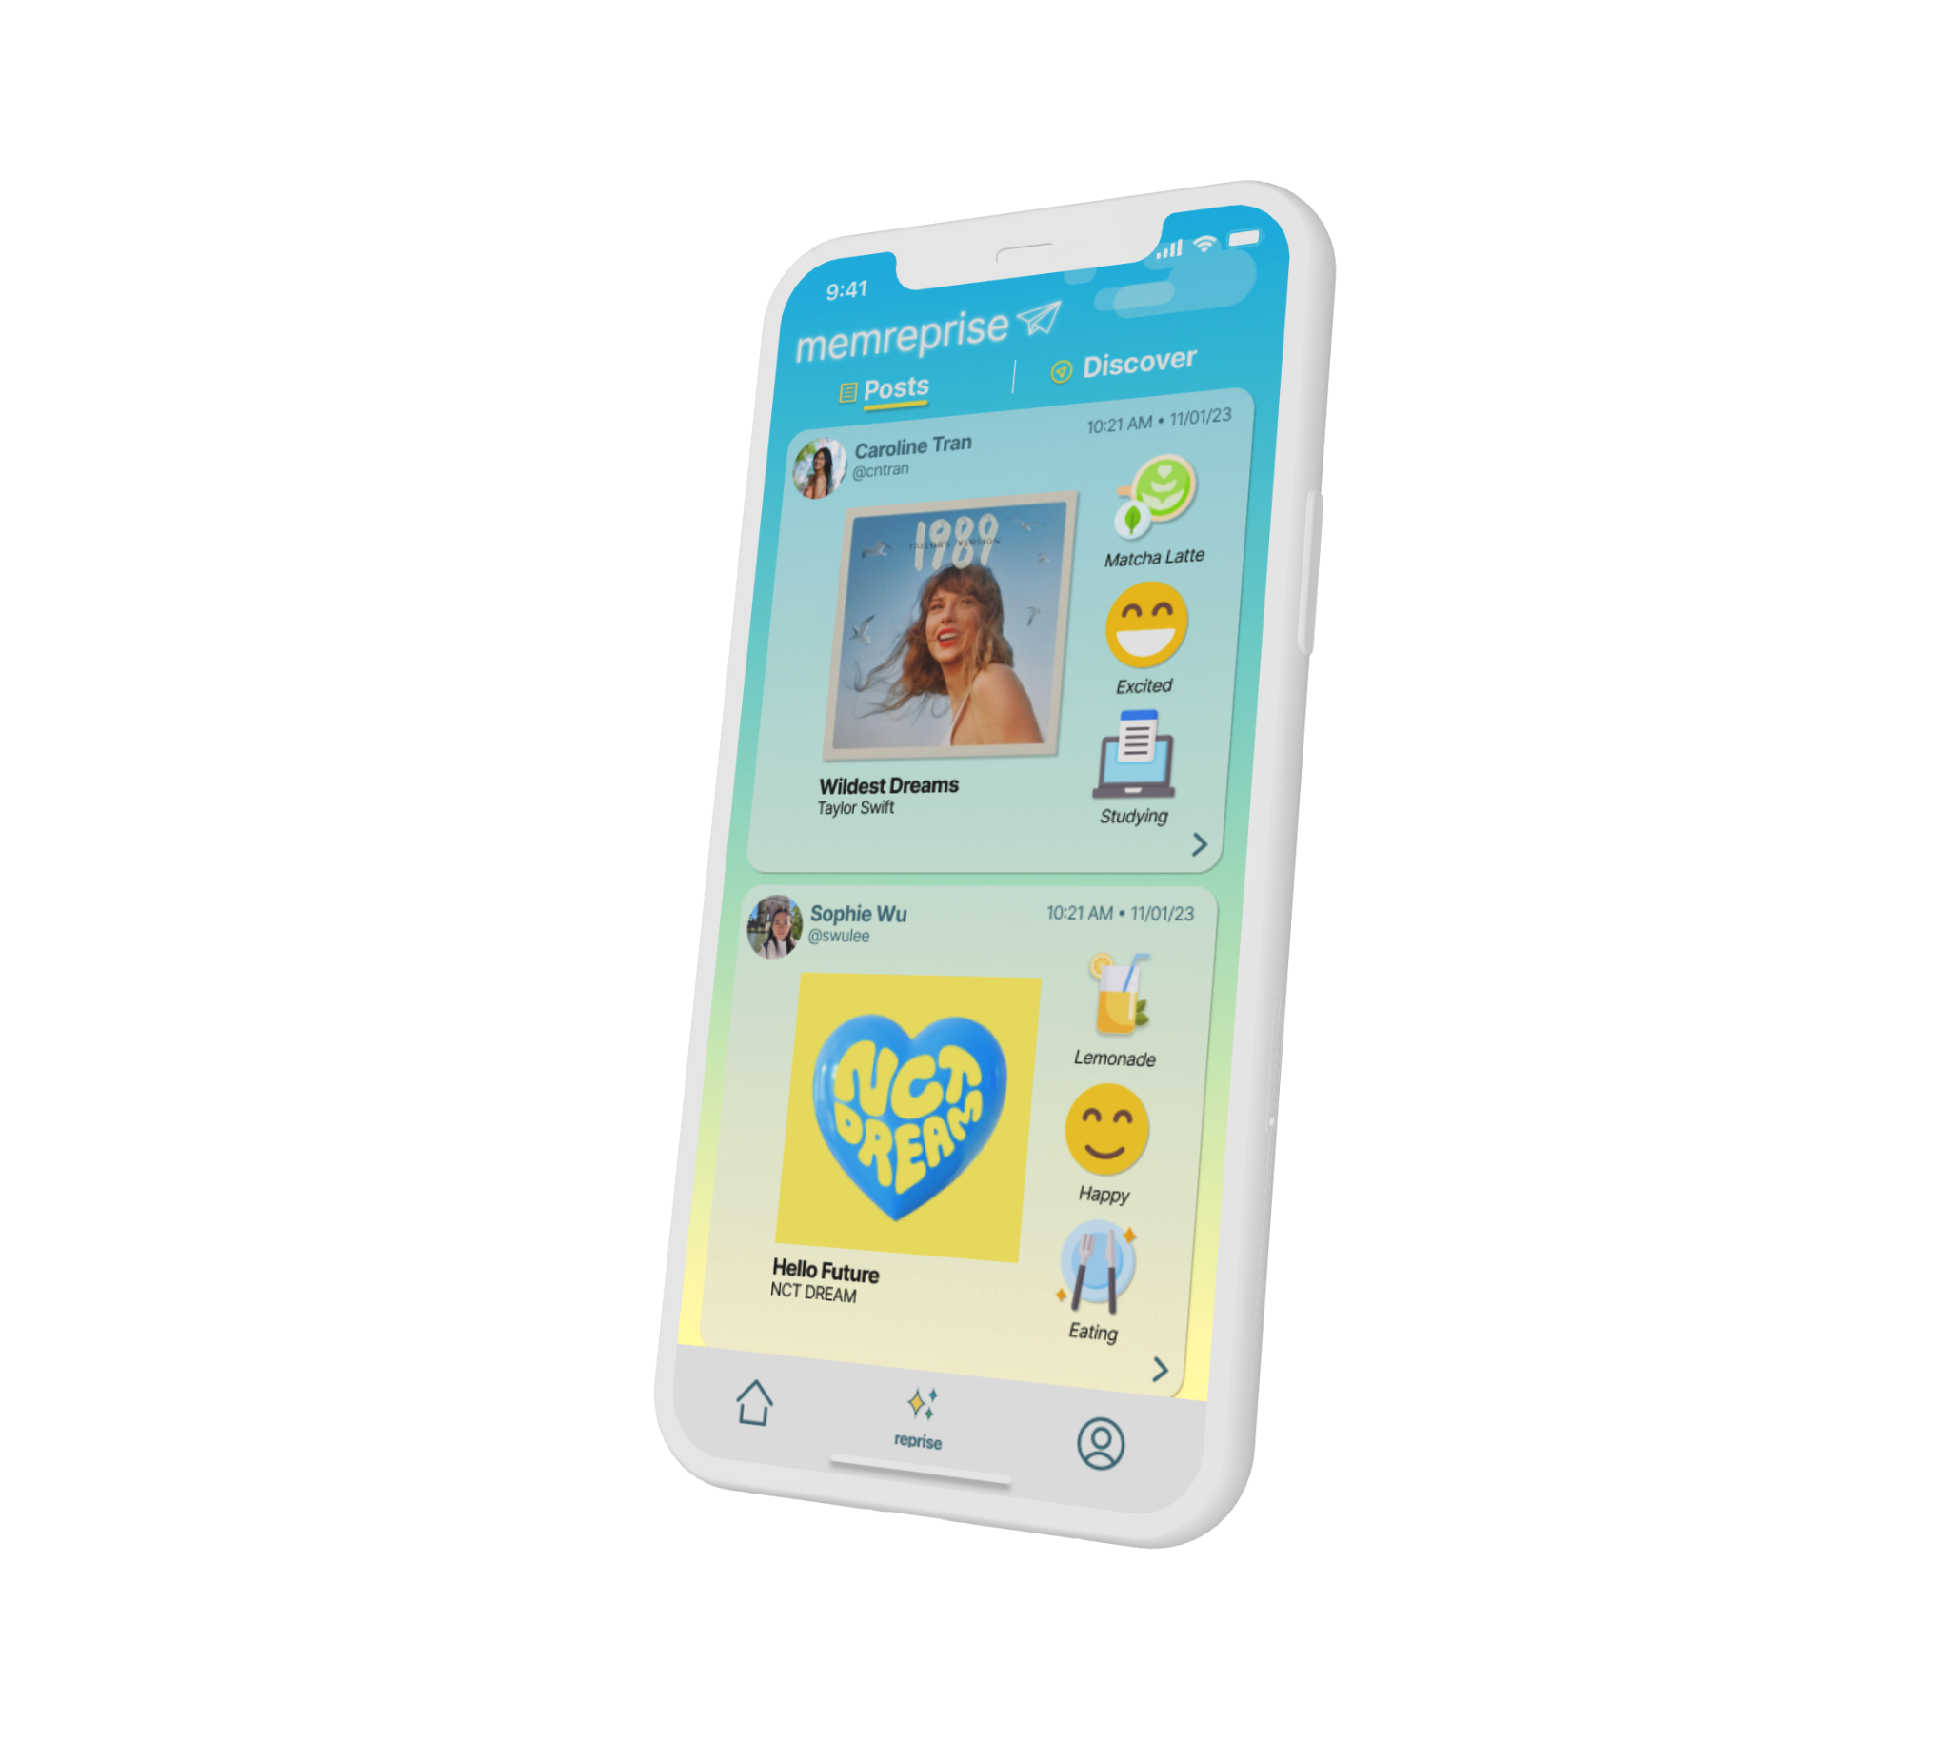
Thanks
Do you have any questions?
memreprise
where music and memories meet

Slide 29
COLOR SCHEME FOR SLIDES
#ffd966
#fce08c
#fff3ce
#1c2e50
#9ecaec
#44aa99
#a2cec6

